Slide 1
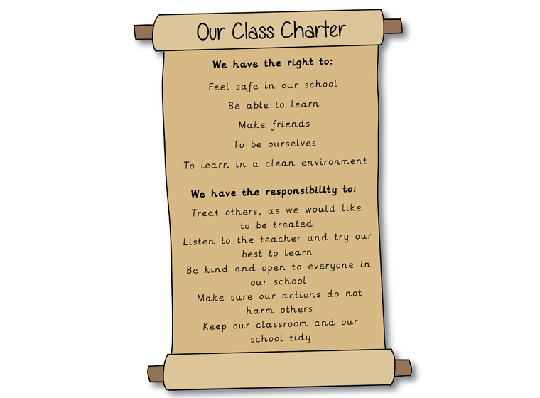
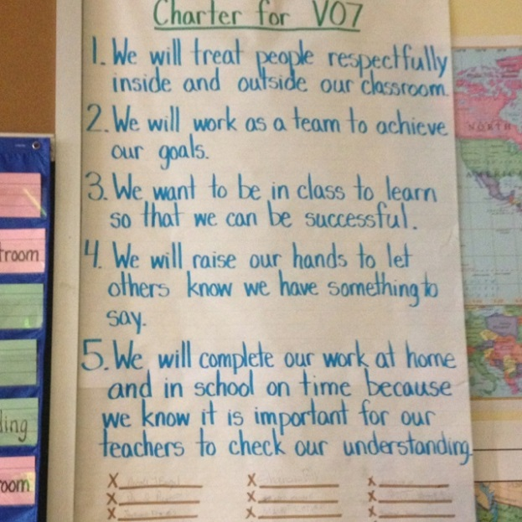
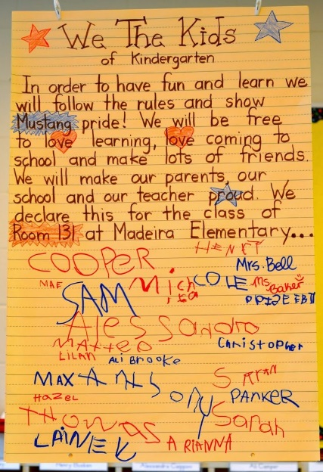
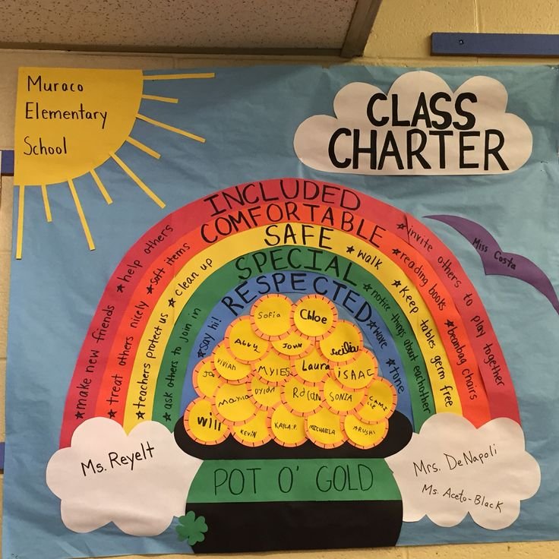
Class Charter
The Students and Teacher in ENTER CLASS NAME HERE
2017-2018
Notes:
Question: What is a charter? Then we discussed it, defined it, and talked about the importance of one.
Handed out a ½ sheet with the 3 guiding questions and they worked on it and then did a group activity, edited their answers, went about our day some more and did another problem solving/cooperative learning activity, and edited their answers.
In a small group, narrowed the feelings down to 5 words then on a poster on the board they brought them all up and we worked on finding overlaps and narrowed it down to 5 “feelings” for the class.
Then I assigned each of the 5 groups to a feeling and asked what would students or teachers be doing for that feeling to happen for you or for others. Then they brought these ideas to the class PowerPoint and we tried to combine them and we found that there was a lot of overlap.
I had group members discuss their answers for #3 and then decide on a group written response and then brought them up to the group charter and we combined and edited.

Slide 2
What is a class charter?
A Charter is a promise and specific behaviors that a group creates for how this group wants to feel and interact.
A charter is important because it differs from “rules” or “guidelines” because it is designed by the group for how they want to feel and how they want to help people and work together in their classroom.

Slide 3
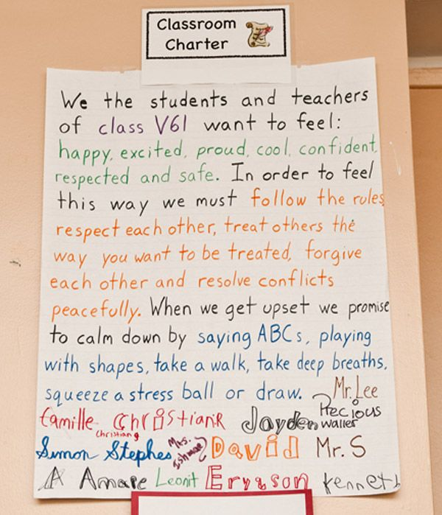
There are three guiding questions to consider when creating a class charter?
As a class, we want to feel…
In order to have these feelings consistently, we will…
We will prevent and manage conflict by…
Notes:
Create a ½ sheet with these questions for students to do on their own and then to share with a table group and then the table group to the class share time. I like to have them do this and then keep

Slide 4
1. How do we want to feel in school each day?
Each student lists ~five feelings he or she wants to experience each day at school.
Then as a table group, the lists are combined to form one list of four to five feeling words that represent what feelings are most important to the class. Bring those up to the board.
Now, the class brings those sticky notes to the board to try and combine the words down to just 5 words and lists them on the sample charter (at the end of the PowerPoint).
Notes:
Bring these up on sticky notes and we will work on bringing our “class” list down to 5 feelings.
List the 5-6 words in the sample or working charter at the end of the PowerPoint.

Slide 5
Here is a list of feelings to help Guide you:
Notes:
Most common words students want to feel are the largest words

Slide 6
2. In order to have these feelings consistently, we will…
Think about what these feelings will look like in school in terms of specific, measurable, observable behaviors
i.e. What will the class need to do each day to ensure everyone experiences these feelings?
Example: In order to feel included, I will greet and smile at classmates every morning when coming into class.
Notes:
Option: Assign a feeling to each table group to discuss and then add to the group chart to organize further through voting or sharing out as table groups.

Slide 7
Now work as a group to get your list of specific behaviors to 5.
Let’s work to get a list of about 5 specific behaviors we would like to see in our class that will help us “feel” the way we want to feel in our classroom.
You can use the sample charter slide to work on combining these ideas.
Notes:
*What can end up happening here is that students list a lot of the same behaviors that other groups list, which means you can combine behaviors or actions when putting this section of the charter together.

Slide 8
3. We will prevent and manage conflict by…
In your groups first discuss:
The uncomfortable feelings and unwanted behaviors they would like to avoid in school.
Example: Teasing, being left out, name calling, spreading rumors
Discuss how these feelings and behaviors will be handled and how conflict will be prevented and managed, including what happens when the Charter is broken or ignored.
Example: I will use an “I statement” if I feel sad, angry, or upset
Notes:
Keep in mind the 5 “feelings” your class wants to have and have each group come up with ways to manage conflict or problems. Have each group submit their ideas and try to combine them and shorten them on the “working” class charter.

Slide 9
Now work as a group to get your list of ways to problem solve to 3 or less.
Let’s work to get a list of 3 ways to problem solve or resolve conflict that we would like to see in our class that will help us “feel” the way we want to feel in our classroom.
Use the “charter” slide to work on the wording.

Slide 10
Draft your Charter here:
We, the 5th grade students and teacher in room 242, will work together to create a classroom where everyone feels…
We will do this by being good classmates. We will…
If a problem or conflict occurs, we will…
We will strive to be good role models for everyone and we will always try our best!
Charlie Brown Mrs. Teacher John Smith Auggie Pullman
Notes:
This is the page where you build the wording for your charter. Feel free to change the wording. ☺

Slide 11
Sample Charter #1

Slide 12
Sample Charter #2
We, the 5th grade students and teacher in Portable #3, will work together to create a classroom where everyone feels safe, happy, respected, confident, and unique.
We will do this by being good classmates. We will make peoples day by smiling, giving compliments, and helping people when they need it. We will respect each other and their choices, by being assertive, using good manners, and listening to others ideas. We want students in our class to be proud and confident. To do this, we will follow school rules, be involved, be determined, and be proud of who we are as individuals.
If a problem or conflict occurs, we will stop-use our own signal word, name the feeling, calm down and use the STEP procedure. If it is a group conflict-use the same procedures but possibly do a class vote or teacher decision.
We will strive to be good role models for everyone and we will always try our best!
Charlie Brown Mrs. Bacon John Smith Auggie Pullman
Notes:
This is the page to work

Slide 13
Sample Charter #3

Slide 14
P3 Class Charter Fall 2017
We, the 5th grade students and teacher in Portable #3, will work together to create a classroom where everyone feels safe, happy, respected, confident, and unique.
We will do this by being good classmates. We will make peoples day by smiling, giving compliments, and helping people when they need it. We will respect others and their choices, by being assertive, saying please and thank you, and listening to others ideas. We want students in our class to be proud and confident. To do this, we will follow school rules, be involved, be determined, and proud of who we are. Remember to not let others determine who you are.
If a problem or conflict occurs, we will…****.
We will strive to be good role models for everyone and we will always try our best!
Sample Charter #4

